Slide 1


Modulation Format vs Data Rate
ET4394 - Wireshark Project
Renzo Arreaza 4567560
Marcelo Guerrero 4736605
Source: https://www.github.com/renzoarreaza/TSS1-Wireshark
Notes:
We want to see how the modulation format and data rate changes in different scenarios

Slide 2
Content
Method
Results
Conclusion
Notes:
Method: how we captured and parsed the data, as well as how we performed the tests
Show the results and finish with a short conclusion

Slide 3
Method
Python script
Data gathering (Tshark)
Data sorting
Matlab
Plotting
Notes:
Data gathering, the output of the tshark command was piped into a text file.
Data Sorting, creating csv file for each PHY type and mac address

Slide 4
Method
Tshark command
"sudo tshark -i "+interface+" -T fields -e wlan_radio.phy -e wlan_radio.data_rate -e wlan_radio.11n.mcs_index -e wlan.bssid -e wlan.da -e frame.time_epoch -f \"wlan type data subtype data or wlan type data subtype qos-data\" -E separator=, -E quote=d -a duration:"+str(duration*60)+" > "+filename
Display filters
wlan_radio.phy
wlan_radio.data_rate
wlan_radio.11n.mcs_index
wlan.bssid
wlan.da
frame.time_epoch
Notes:
MCS index: Spatial Streams, Modulation Type, Coding Rate and Data Rate
bssid: AP mac address
da: destination address
time_epoch: time stamp

Slide 5
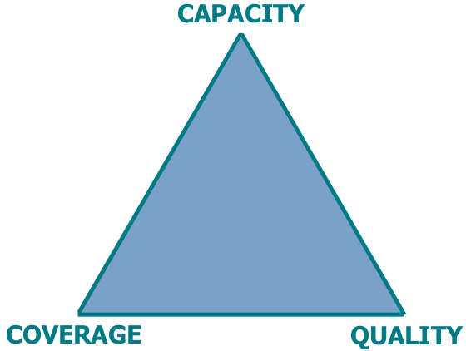
Method
Test 1 (Coverage vs Quality)
Single user in different locations
Test 2 (Quality vs Capacity)
Varying number of users in one location
Notes:
For both tests, we recorded traffic for 30 minutes, changing the parameters every 10 minutes.
So for test1, we changed places. For the second test we recorded traffic of a single user for the first 10 minutes, added more users in 2 second window, and ended with again only 1 user.

Slide 6
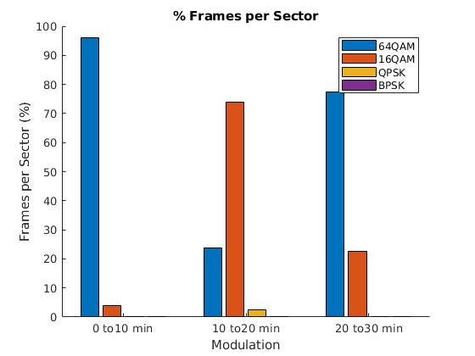
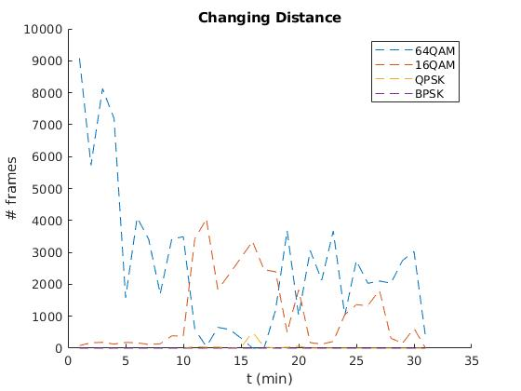
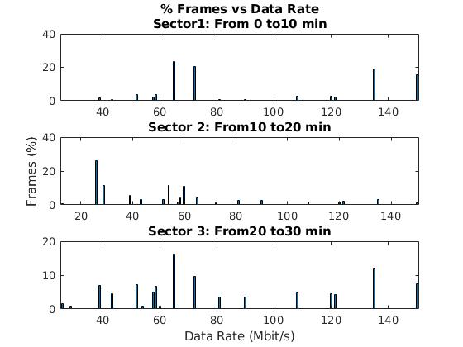
Test 1 - 802.11n
Notes:
location1: same room as AP
location2: farthest place/room from AP
location3: room between location 1 and 2
a: 1. mostly 64qam, 2. mostly 16qam, 3. inbetween
b: same as above
c: 1. high low around the same, 2. mostly low, 3. evenly spread

Slide 7
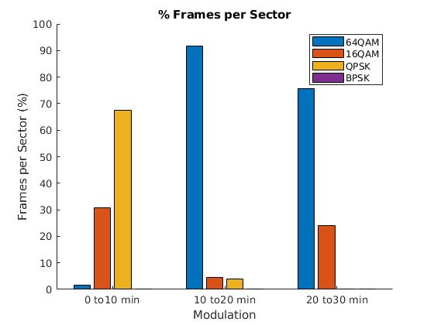
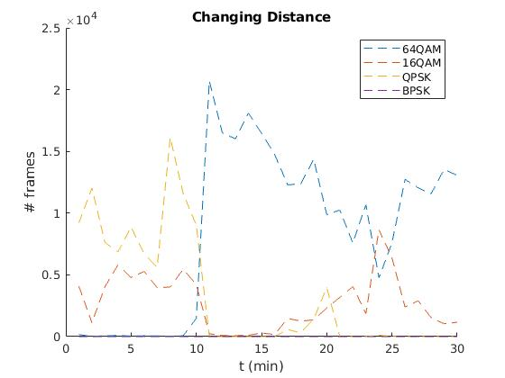
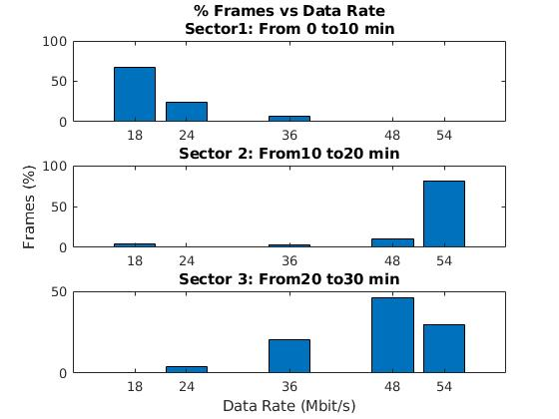
Test 1 - 802.11g
Notes:
Location1: ground floor
Location2: first floor (AP location)
Location3: second floor

Slide 8
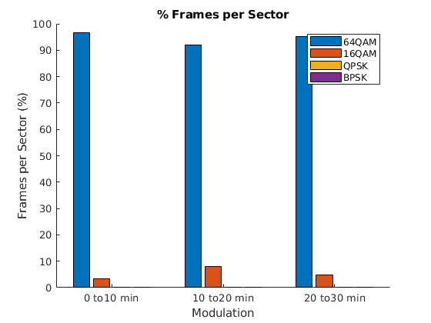
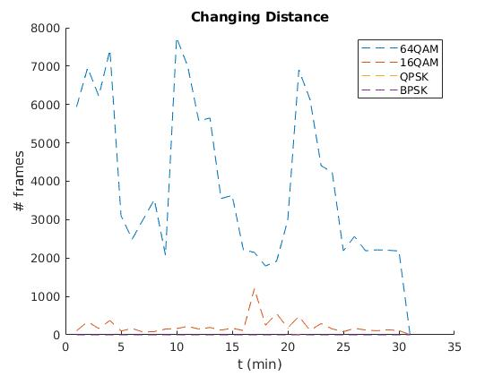
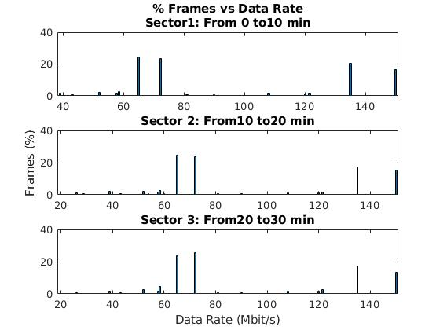
Test 2 - 802.11n
Notes:
Varying number of users, single location
Clearer on second graph. 16QAM usage goes from 4% to 8%.
4 extra users in second window

Slide 9
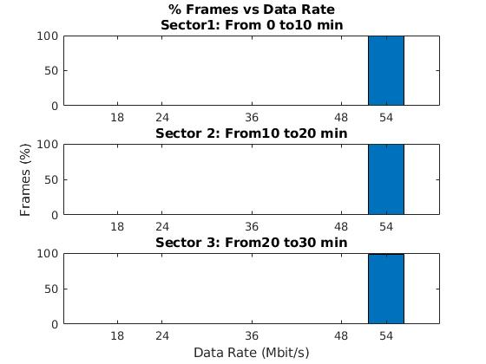
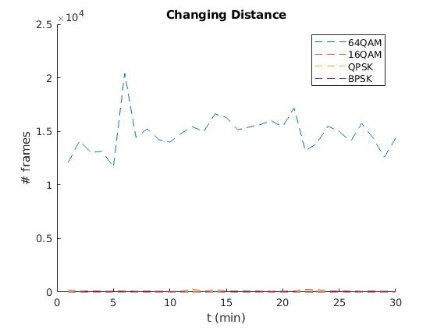
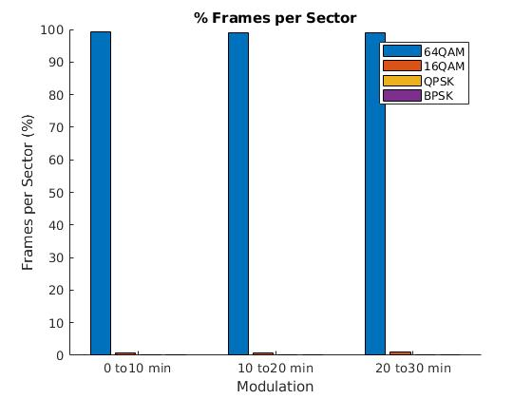
Test 2 - 802.11g
Notes:
Results not as clear, only 2 extra users.

Slide 10
Conclusions
No direct relation between modulation and data rate
Coding rate
Bandwidth of the channel
Spatial streams
Guard intervals
CCQ tradeoff
Notes:
1: was visible in some of the tests
2: capacity, coverage, quality

Slide 11
Modulation Format vs Data Rate
ET4394 - Wireshark Project
Renzo Arreaza 4567560
Marcelo Guerrero 4736605
Notes:
Questions?

